Slide 1
Truck ‘n Trailer problem
MECENG C231A Final Project
Eric Chuang (3042017488), Evan Grealish (3041927255), Lennart Peus (3042039731),
Seongjae Ahn (3038131605), Toh Wayne (3036062886), Yuwei Chang (3041922432)

Slide 2
Overview
Problem statement
Dynamics Models
Constraints
Cost function
MPC implementation
Results
Conclusion

Slide 3
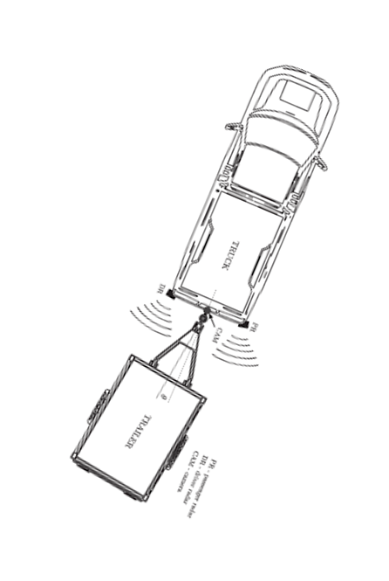
Problem Statement
“Truck ‘n Trailer”
Stable in Forward Motion.
Unstable in Reverse Motion,
Jackknife Effect: Uncontrollable divergence in hitch Angle

Slide 4
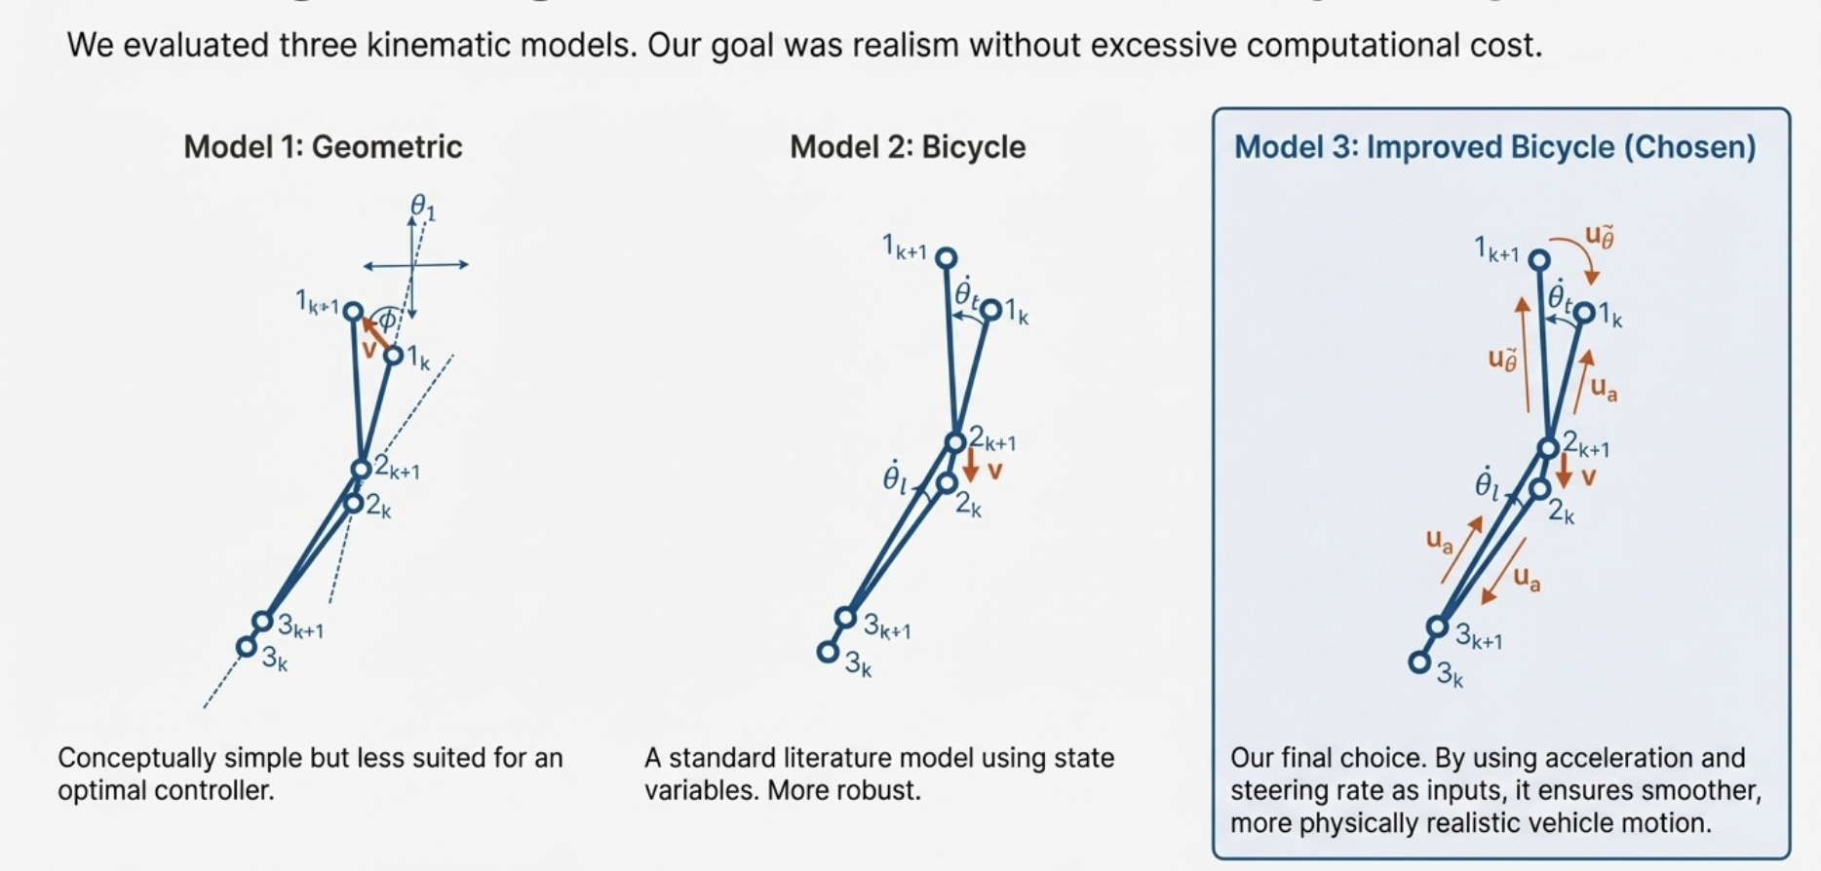
Dynamics models

Slide 7
1. PREDICTION:
- MPC predicts obstacle positions for next 20 steps (2.0 seconds)
- Uses constant velocity model: pos(t) = pos(0) + velocity × t
- At each step, obstacle position is: [5.0, 8.0] + [0.0, -2.5] × t
2. CONSTRAINT GENERATION:
- For each time step t in horizon [0, 20]:
* Predict obstacle position at time t
* Add constraint: ||truck_pos(t) - obstacle_pos(t)|| >= safety_radius
- Safety radius = obstacle_radius + truck_radius + margin
- Safety radius = 0.3 + 1.5 + 1.2 = 3.0 m
3. OPTIMIZATION:
- MPC solves optimization problem with all predicted constraints
- Finds trajectory that:
* Reaches target (or gets close)
* Avoids all predicted obstacle positions
* Minimizes control effort
4. REPLANNING:
- After executing first step, MPC:
* Updates obstacle positions (they've moved)
* Rebuilds prediction with new positions
* Replans entire trajectory
- This handles: model errors, disturbances, measurement noise
5. WHY PREDICTABILITY IS GOOD:
- Predictable obstacles = better planning
- MPC can plan optimal paths when it knows obstacle trajectories
- Replanning handles any deviations from predictions
- For unpredictable obstacles, would need probabilistic/robust MPC
6. CONSTRAINT EQUATION (from code):
For obstacle o and time step t:
obs_x(t) = obs_x0 + obs_vx × t × dt
obs_y(t) = obs_y0 + obs_vy × t × dt
Constraint: (truck_x(t) - obs_x(t))² + (truck_y(t) - obs_y(t))² >= min_distance²
This constraint is added for:
- Each obstacle (o = 0, 1, 2, ...)
- Each time step in horizon (t = 0, 1, 2, ..., 20)
- Total constraints: 1 obstacle × 21 time steps = 21 constraints
7. WHY PREDICTABILITY IS EXPECTED:
- MPC is a PREDICTIVE controller - it uses predictions!
- If obstacles are predictable, MPC can plan optimal paths
- Replanning at each step handles:
* Model errors (truck doesn't follow exact predicted path)
* Disturbances (wind, road conditions)
* Measurement errors
* Small changes in obstacle behavior
- For truly unpredictable obstacles, would need:
* Probabilistic MPC (uncertainty in obstacle motion)
* Robust MPC (worst-case planning)
* Sensor fusion (tracking with uncertainty)
8. CURRENT LIMITATIONS:
- Assumes constant velocity (linear prediction)
- No uncertainty handling (deterministic)
- No reactive obstacle behavior
- For real-world: would need sensor fusion, uncertainty bounds

